Slide 1
Electrical Power

Slide 2
Rate of work done
If you wanted to buy a new kettle, you might consider how quickly different kettles boil the water.
All appliances have (or at least should have) a power rating printed on them somewhere.
Power is a measure of how fast energy is converted by the appliance.

Slide 3
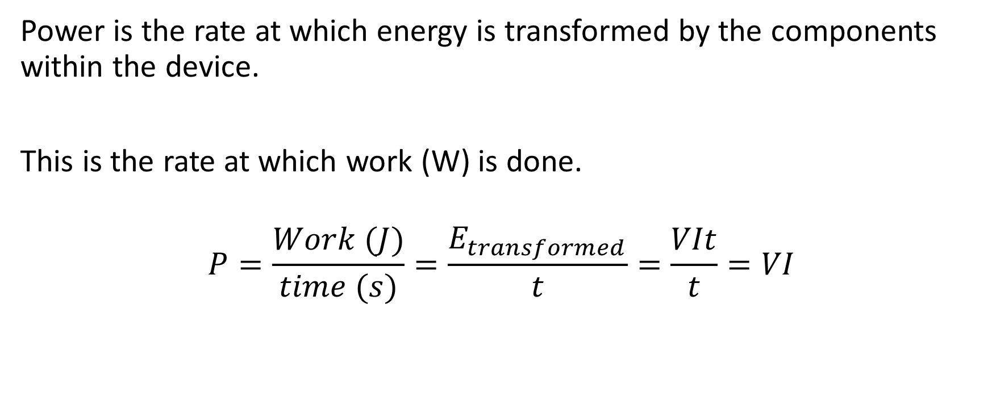
Rate of doing work
Power is the rate at which energy is transformed by the components within the device.
This is the rate at which work (W) is done.
$$P=\frac{Work (J)}{time (s)}=\frac{E_{transformed}}{t}=\frac{VIt}{t}=VI$$

Slide 4
Power
Measured in watts (W)
1 watt is equal to 1 joule per second.

Slide 5
